Slide 1
SMS Messenger System
Team 3: Alec, Sharan, Twisha, Tanishq, Quang, Rene
Notes:
Tanishq

Slide 2
Objective
Our objective is to build a comprehensive SMS Messenger Software designed for consumers to manage personal communication effectively.
Notes:
Tanishq

Slide 3
Cost Estimation - Hardware
List of Hardware
-SMS Gateway -4G Modem -SIM cards -External Antenna
-Server/Host Machine (Linux OS) -Network Equipment
Cost Range - $3,000 - $5,000
Notes:
Rene

Slide 4
Cost Estimate - Software Development
Develop for medium/large application and Client-Server
Cost Range - $50,000 - $75,000
Yearly Maintenance Cost - $15,000 - $30,000
Notes:
Rene

Slide 5
Cost Estimate - Personal
Full Development Team - 8 personals
$75 - $150 per hour
$144,000 - $288,000 salary
Cost Range - $1,152,000 - $2,304,000
Notes:
Rene

Slide 6
Functional Point
External Input (EI) FP: 11
Compose and Send SMS
Inbound SMS receive
User Login
External Output (EO) FP: 5
Delivery Status

Slide 7
Functional Point
External Inquiries (EQ) FP: 20
Message View Message Delete
Message Sent Message Edit
Message Search
Internal FIles (ILF) FP: 8
Message Data
Message Schedule

Slide 8
Functional Point
External Interfaces (EIF) FP: 7
SMS Gateway
Total FP: 51

Slide 9
Functional and Non-Functional Requirements
Functional:
FR1: The system shall allow a user to compose and send SMS messages to one or more contacts.
FR2: The system shall allow a user to receive, view, reply to, and forward incoming SMS messages.
FR3: The system shall display all messages exchanged with a specific contact in a chronological Conversation View.
FR4: The system shall allow users to save, edit, and delete unsent message drafts.
FR5: The system shall allow users to search for specific messages using text queries and categorize them by contact name and phone number.
FR6: The system shall allow users to schedule messages to be sent at a future date and set up automatic replies based on user-defined criteria.
Non-Functional:
NFR1: Usability requirement: The system's user interface shall provide zoom and scroll capabilities, allowing a new user to compose and send a message in fewer than 3 steps without prior training.
NFR2: Security requirement: The system shall require user authentication upon opening the app and encrypt all locally stored messages and contact information to prevent unauthorized access.
NFR3: Environmental requirement: The system shall be compatible with the standard mobile operating environments targeted by the team and function without interfering with other native device applications.
NFR4: Regulatory requirement: The system shall format and transmit all SMS messages in compliance with standard national telecommunications regulations and carrier packet rules.
NFR5: Safety/security requirement: The system shall comply with privacy legislation by providing a "Complete Data Wipe" function that safely and permanently deletes all personal messages and contacts upon the user's request.
Notes:
Twisha On Slide 10, we outline the requirements that define the scope of our SMS Messenger. Our Functional Requirements bridge the gap between basic messaging and advanced automation. While FR1 through FR3 handle standard message flow, FR6 specifically introduces our unique 'Auto-Reply' and 'Scheduled' features, which we believe differentiate us from default system apps.
Turning to Non-Functional Requirements, we prioritized security and usability. For instance, NFR2 ensures that all local message history is encrypted and requires biometric or passcode authentication. Furthermore, we've designed the UI (under NFR1) so that a user can go from opening the app to sending a message in three steps or fewer, ensuring zero training is required for basic tasks.
------
"On Slide 19, we are demonstrating the Test Plan for our Message Search module. As part of our commitment to high software quality, we utilized JUnit 5 for automated unit testing.
In the 'True' test case shown here, we input a query for a keyword known to exist in our mock database—'Project'—and verified that the system correctly returned the intended message. In the 'False' test case, we queried for a term that does not exist—'Pizza'—to verify that the system handles empty results gracefully without crashing. This automated approach allows us to verify that our search logic is case-insensitive and efficient before it is integrated into the final user interface

Slide 10
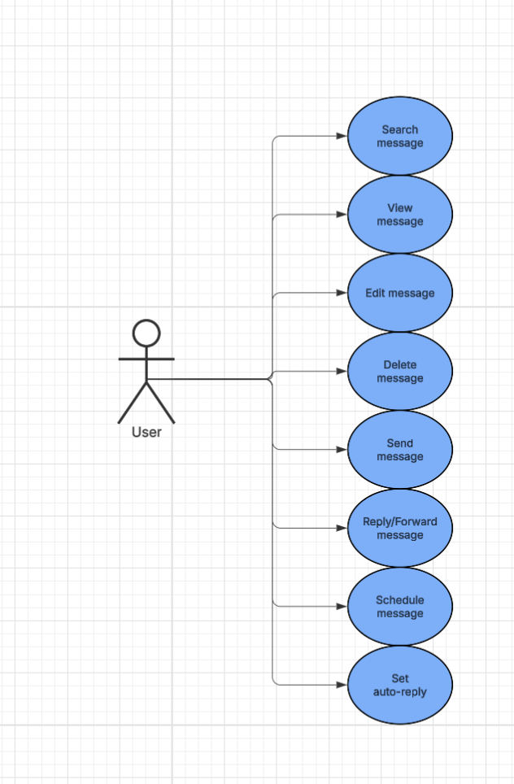
Use Case Diagram
Notes:
Alec

Slide 11
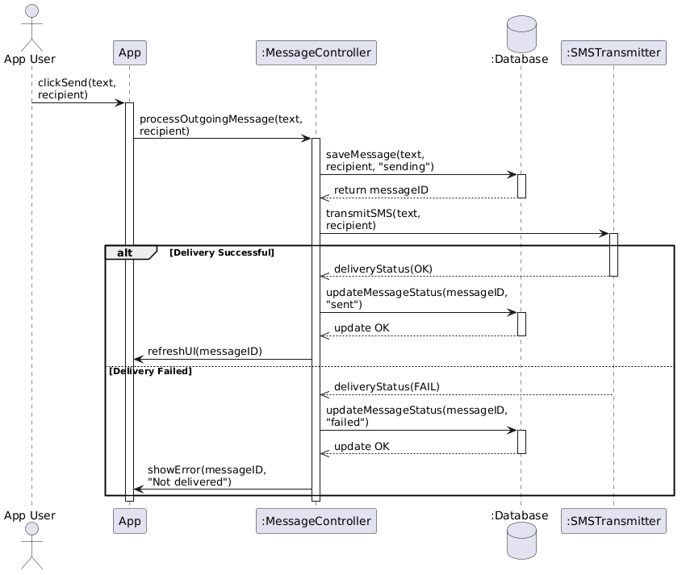
Sequence Diagram 1 (Send Message)
Notes:
Quang

Slide 12
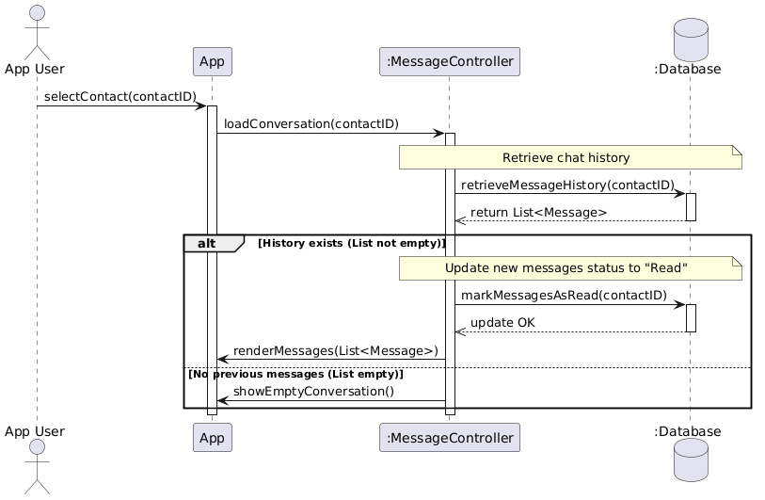
Sequence Diagram 2 (View Message)
Notes:
Quang

Slide 13
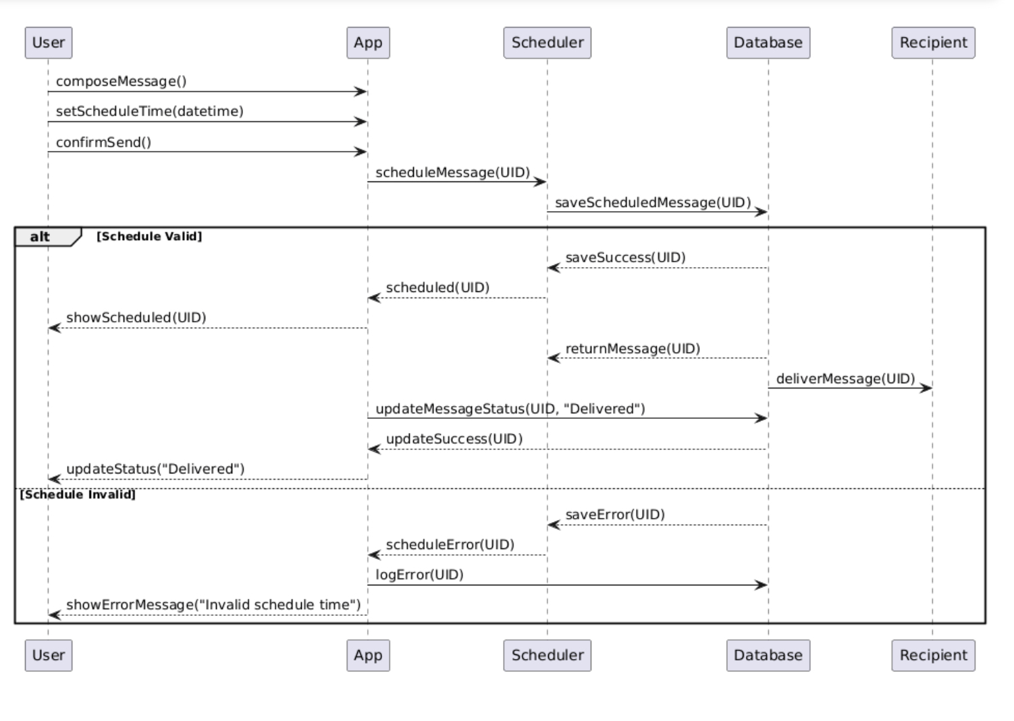
Sequence Diagram 3 (Schedule Message)
Notes:
Sharan

Slide 14
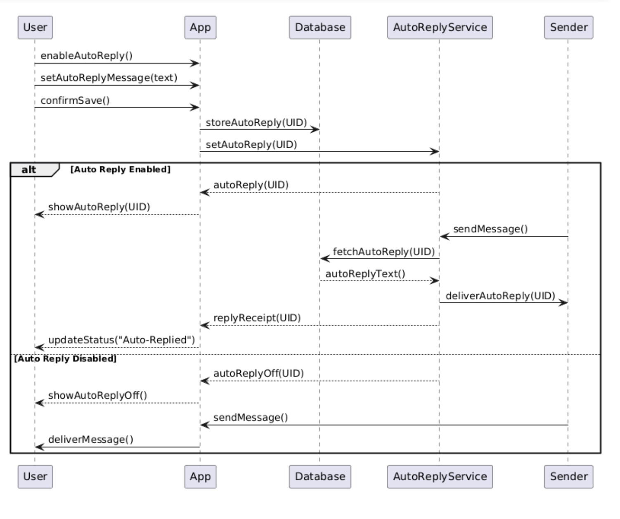
Sequence Diagram 4 (Auto Reply)

Slide 15
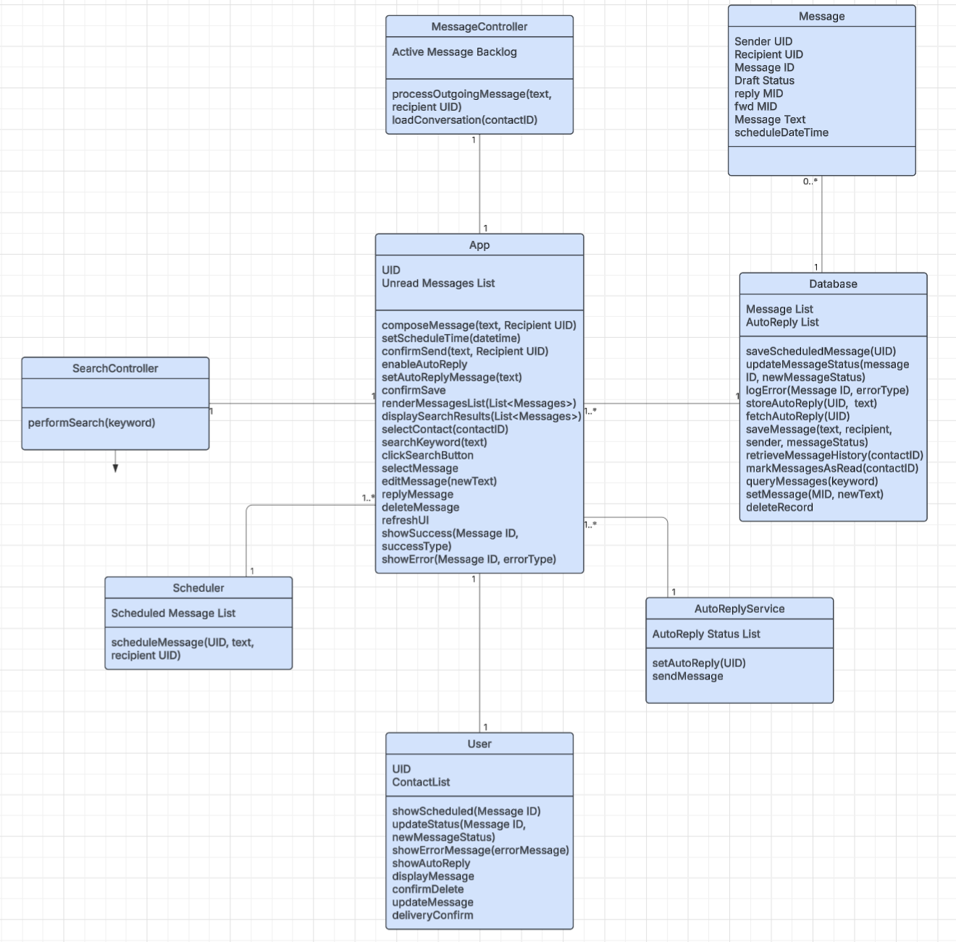
Class Diagram
Notes:
Alec

Slide 16
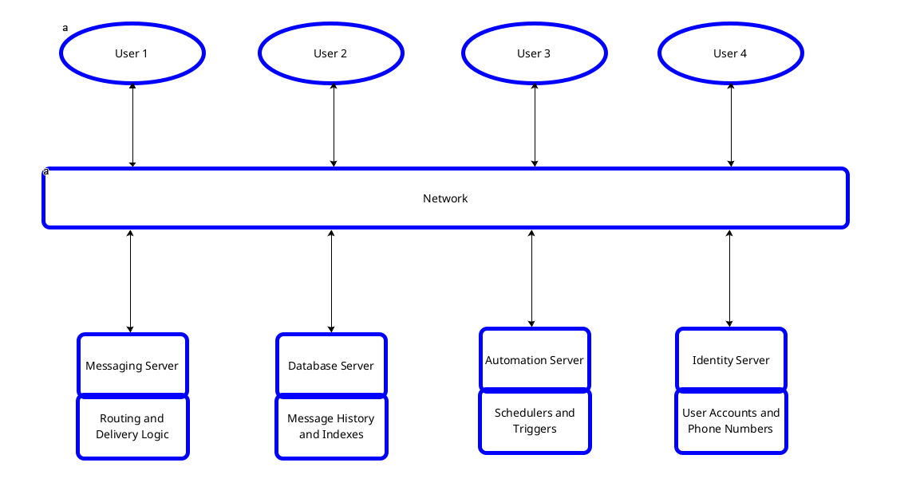
Architectural Diagram
Notes:
Tanishq

Slide 17
Project Timeline
6 months to develop the software
1st Phase - Planning stage to set the requirements and the development process (3-4 weeks)
2nd Phase - The Design phase which is the structural part and the framework which is also backend. (6-10 weeks)
3rd Phase - The UI, the local stuff for the user and the functionalities which is the front end part. ( 6-8 weeks)
4th phase - The testing stage and to fix any arising issues or change the requirements to fix and launch the software. (3-4 weeks)
Notes:
Sharan

Slide 18
Comparison with Similar Designs
Core Value: Focuses on individual-level automation, filling feature gaps left by default messaging apps.
Scheduled Messaging (Cross-Platform): Utilizes a Client-Server architecture to execute countdowns on the server.
Ensures reliable delivery regardless of the recipient's OS, bypassing closed-ecosystem barriers (like iMessage).
Auto-Reply for Peer-to-Peer (P2P): Empowers regular users with flexible, customizable automated responses.
Unlike RCS and iMessage, which restrict robust auto-reply features primarily to Business accounts.
Notes:
Quang

Slide 19
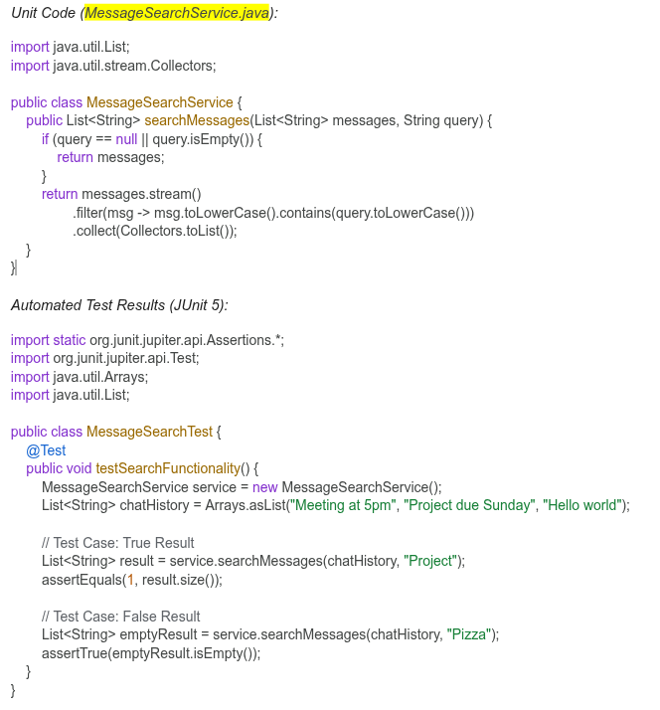
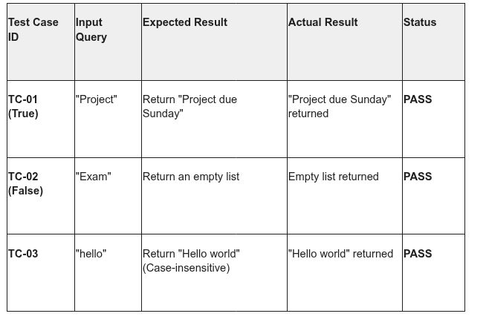
Test Plan Demonstration
Notes:
Twisha On Slide 19, we are demonstrating the Test Plan for our Message Search module. As part of our commitment to high software quality, we utilized JUnit 5 for automated unit testing.
In the 'True' test case shown here, we input a query for a keyword known to exist in our mock database—'Project'—and verified that the system correctly returned the intended message. In the 'False' test case, we queried for a term that does not exist—'Pizza'—to verify that the system handles empty results gracefully without crashing. This automated approach allows us to verify that our search logic is case-insensitive and efficient before it is integrated into the final user interface

Slide 20
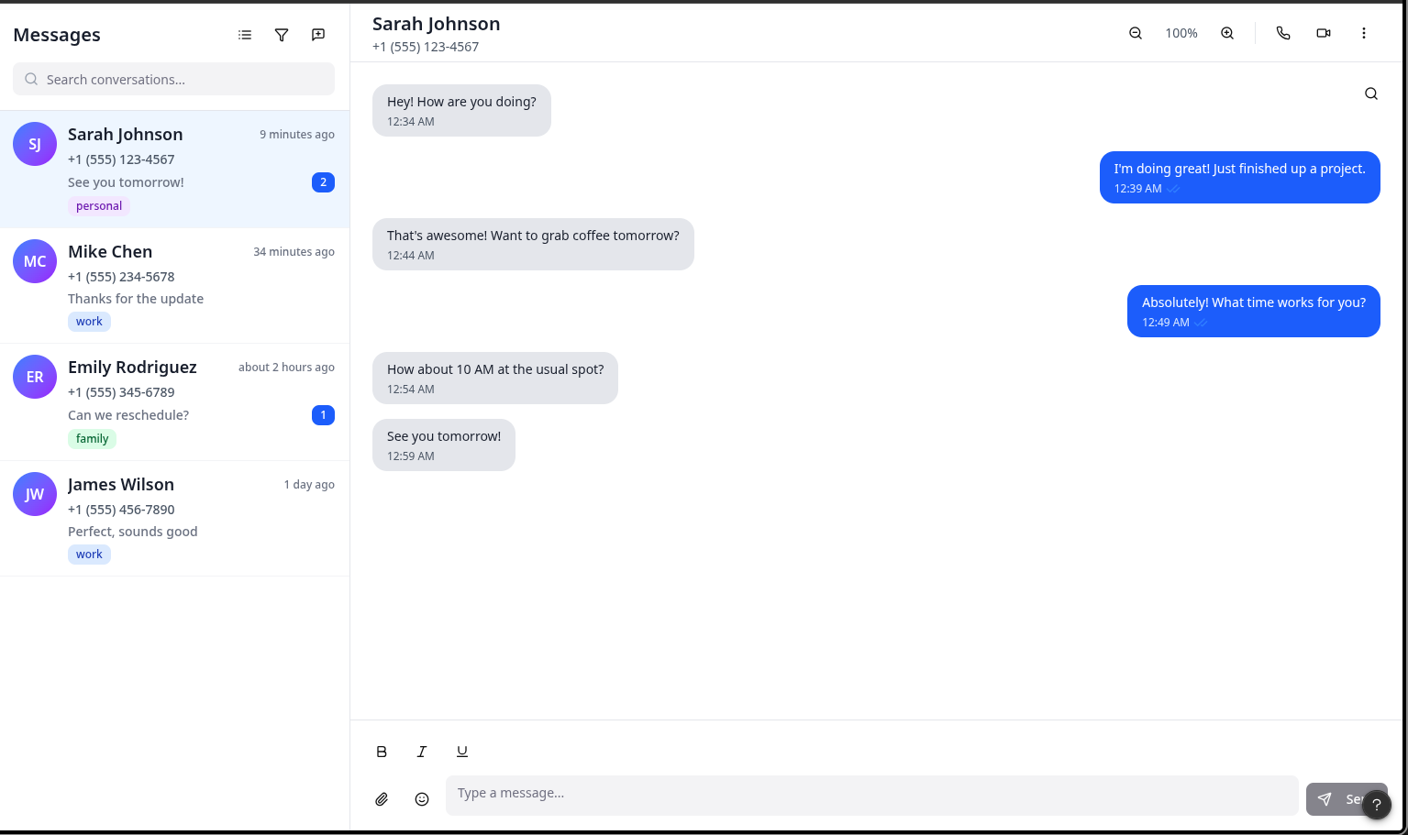
Prototype
Notes:
Tanishq

Slide 21
Challenges, Lesson Learned, and Conclusion
Challenges:
Although there were some difficulties in cost estimation sourcing for the most part the project was manageable.
Lesson Learned:
Through the process of completing this project we learned about software planning design and testing, critical skills for any software engineer.
Conclusion:
This final phase refined our design plans, constructed scheduling and cost estimates and gave us guidance as to what we really have to offer when compared with market rivals.
Notes:
Alec

